Slide 1

Department of Electronics & Communication Engineering
University Institute of Technology RGPV, Bhopal SESSION : 2020-2024 Topic: IDENTIFICATION OF PSYCHOTIC DISORDER “SCHIZOPHRENIA” USING EEG SIGNALS Major Project Presentation Group No. 18
Name of Faculty mentor:
Dr Vineeta Saxena Nigam
STUDENT MEMBERS :
0101EC201076 : Kritika Pathak
0101EC201090 : Niharika Bhargava
0101EC201092 : Nikita Puri
0101EC201094 : Nishi Priya

Slide 2

OBJECTIVES :
To find the suitable database for psychotic disorder.
The signal processing method for computing features for discrimination.
To find suitable methods for automatic identification of psychotic disorders.

Slide 3
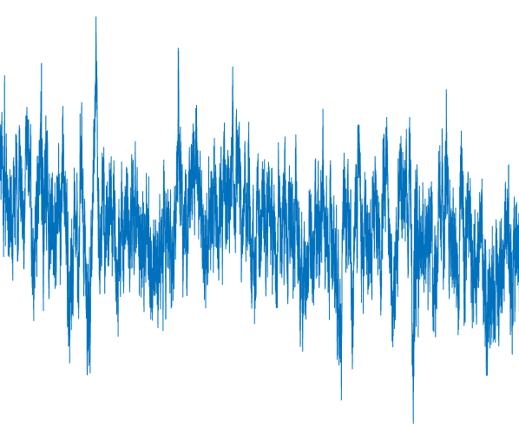
INTRODUCTION :
An electroencephalogram (EEG) is a recording of brain activity. During this painless test, small sensors are attached to the scalp to pick up the electrical signals produced by the brain.
Schizophrenia is a serious and disabling mental illness. It is manifested as obstacles such as thinking, emotion, and behavior, the condition shows a slow and progressive development, and there are various degrees of social function defects. Symptoms include false beliefs, unclear or confused thinking, hearing voices that others cannot hear, reduced social participation and emotional expression, and lack of motivation.

Slide 4

MOTIVATION :
Schizophrenia is a brain disease that frequently occurs in young people.
Early diagnosis and effective intervention and treatment of schizophrenia can improve the disease.
Using deep learning to analyze paranoid schizophrenia {s} and healthy control {h} individuals all at once is ground breaking. It has the potential to pioneer transformative advancements in neurocognitive dysfunction disease understanding and treatment strategies.

Slide 5
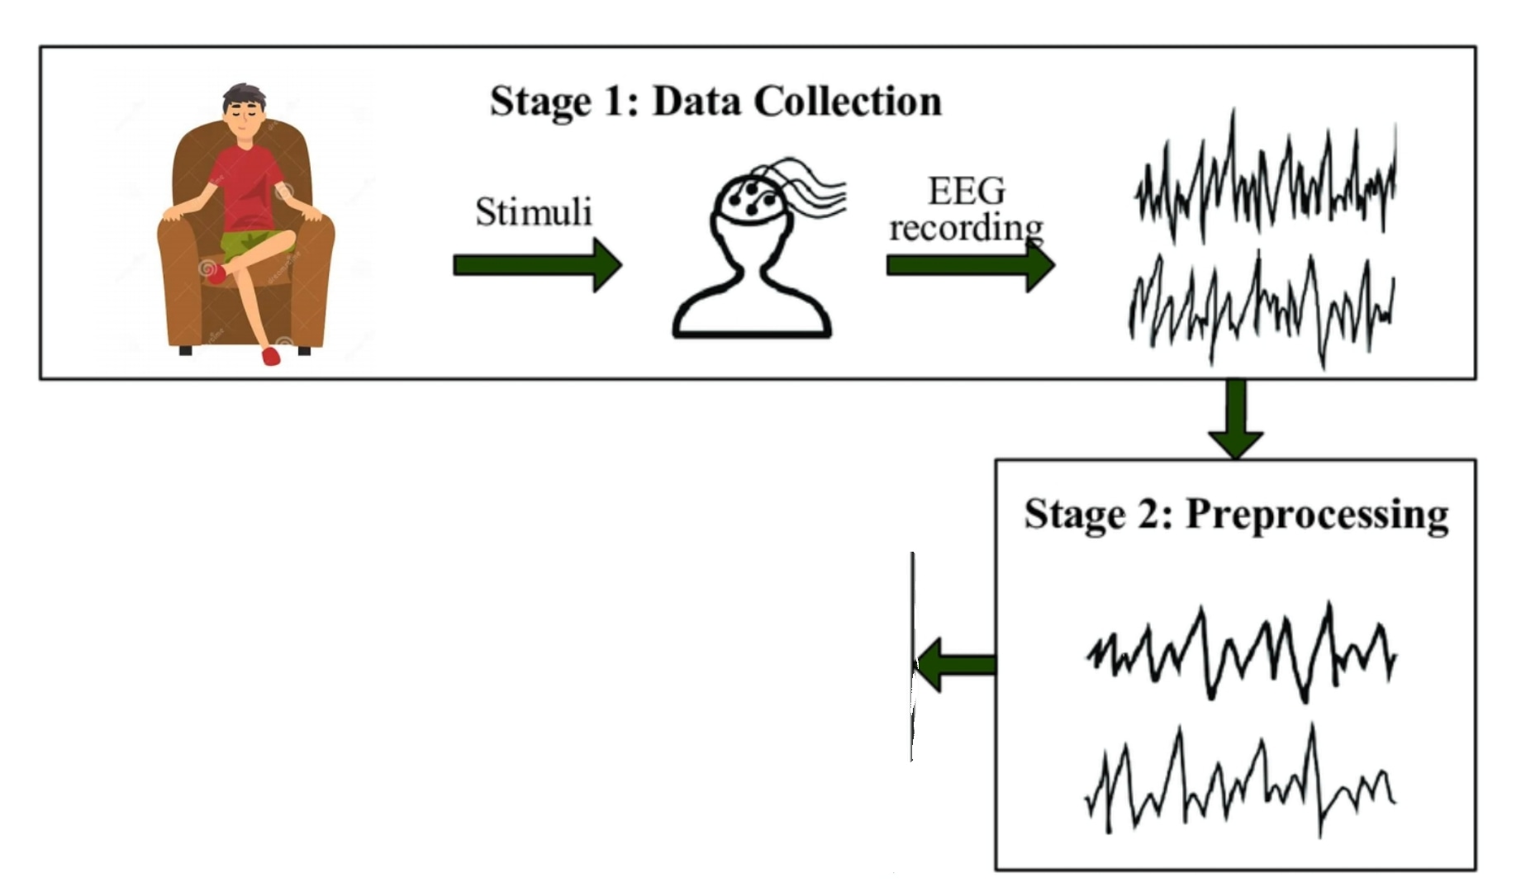
Paranoid Schizophrenia
{s} Group
Stage 3 : Model Training and Evaluation
AlexNet
VGG16
Mobilenet
Healthy
{h} Group

Slide 6
Dataset :
28 Subjects
We had 28 Subjects initially , each of them belonging either of the two classes, that is paranoid schizophrenia {s} and healthy {h}.
14 of them were diagnosed with paranoid schizophrenia i.e. {s}-group and 14 were healthy subjects i.e. {h}-group.
Each recording was performed according to the clinical protocol with participants being in a sitting position having their eyes closed.
14 {s} PATIENTS
14 {h}
PATIENTS

Slide 7
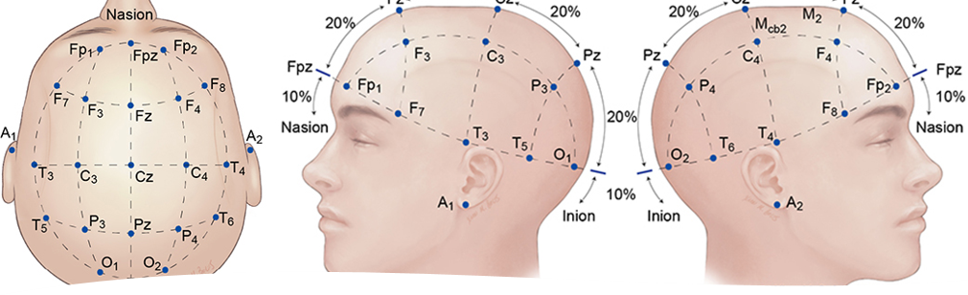
Electroencephalogram (EEG) signals were obtained from 19 scalp electrodes and 2 reference electrodes using the 10–20 system, a globally acknowledged approach for defining and placing scalp electrodes during EEG examinations.
The sampling rate was set at 250 Hz using the standard 10-20 EEG montage with 19 EEG channels: Fp1, Fp2, F7, F3, Fz, F4, F8, T3, C3, Cz, C4, T4, T5, P3, Pz, P4, T6, O1, O2.
The reference electrode was placed between electrodes A1 and A2.

Slide 8
STAGE 1:
Data Acquisition: The EEG signals were obtained from a RepOD dataset, with the sampling frequency of 250 Hz using the standard 10-20 EEG montage with 19 EEG channels: Fp1, Fp2, F7, F3, Fz, F4, F8, T3, C3, Cz, C4, T4, T5, P3, Pz, P4, T6, O1, O2.
Channel Selection: The F4 electrode channel was chosen for analysis. Its selection ensured consistency and facilitated efficient data processing, though alternative channels could have been selected based on research objectives.
Signal Visualization: EEG signal traces from the F4 channel were plotted to visualize psychotic activity across subjects. These plots serve as foundational references, revealing patterns and trends in brain oscillations for subsequent analysis.

Slide 9
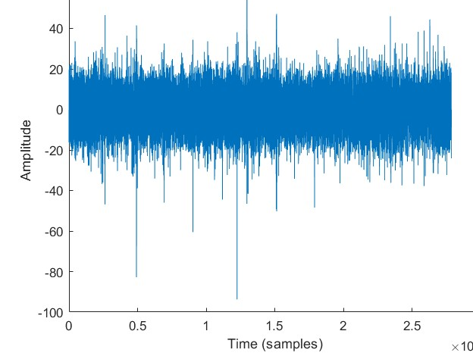
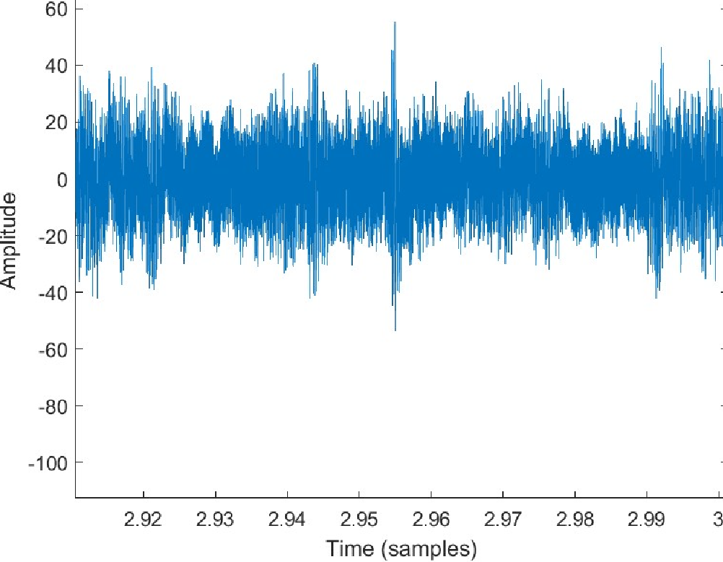
{s} GROUP
{h} GROUP

Slide 10

CODE USED :

Slide 11
Paranoid Schizophrenia
{s} Group
Stage 3 : Model Training and Evaluation
AlexNet
VGG16
Mobilenet
Healthy
{h} Group

Slide 12
STAGE 2:
SEGMENTATION PROCESS
The segmentation process involved dividing the EEG data into smaller segments of fixed size, defined by the variable segment_size.
This was achieved by iterating over each subject, loading their corresponding EEG data, and calculating the number of segments based on the data length and segment size. For each segment, the start and end indices were determined, allowing for the extraction of the segment from the EEG data.
These segments facilitated the analysis of the EEG signal's frequency content over shorter time intervals, aiding in the detection of temporal changes in brain activity patterns.

Slide 13


Slide 14
Time Frequency Representation
The Short-Time Fourier Transform (STFT), is used to determine the sinusoidal frequency and phase content of local sections of a signal as it changes over time and by converting the STFT magnitude to decibels (dB), we have enhanced its interpretability.
Subsequently, the magnitude of the STFT was visualized as images, with time depicted along the horizontal axis, normalized frequency along the vertical axis, and magnitude represented by color intensity. These visual representations provided valuable insights into the dynamic frequency characteristics of brain activity across segmented EEG data, facilitating the identification and analysis of temporal changes in neural processes.

Slide 15
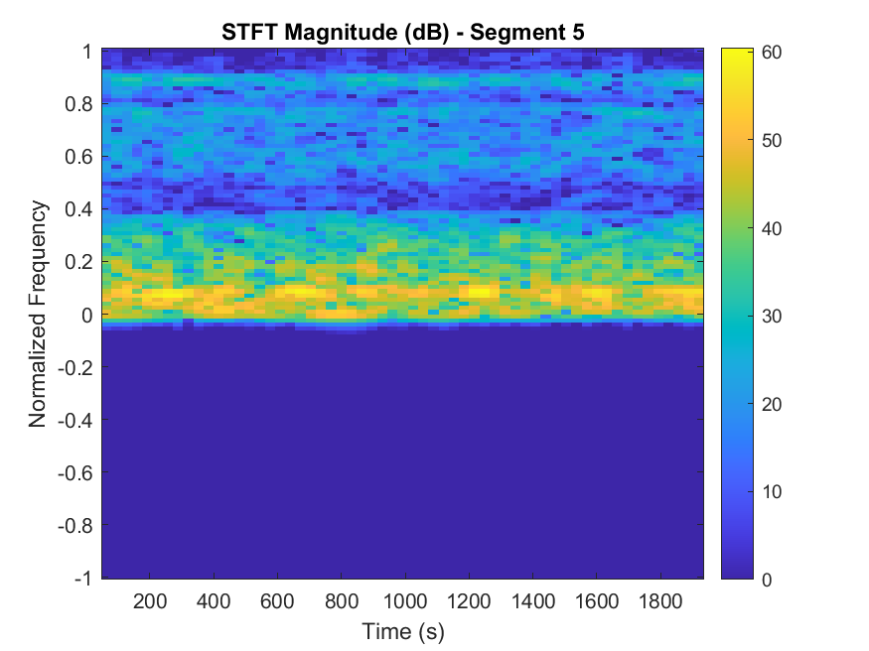
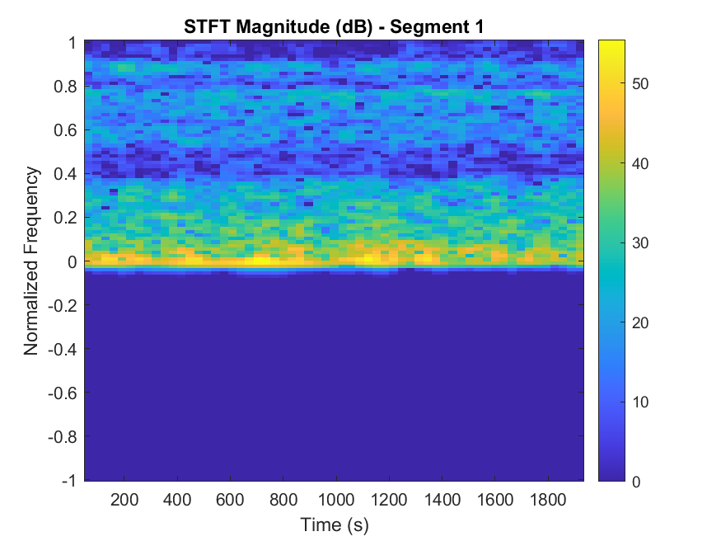
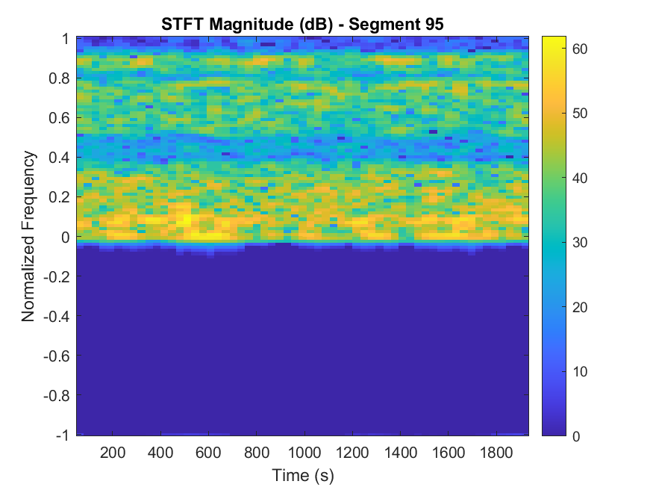
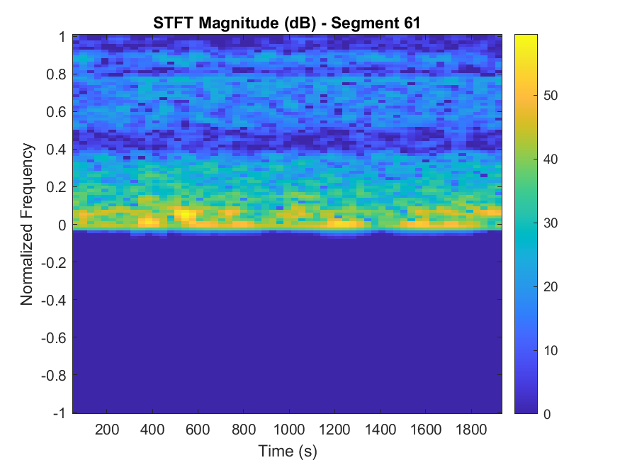
2-D IMAGES FOR PROCESSING PURPOSES
{s} GROUP
{h} GROUP

Slide 16

CODE USED :

Slide 17


Slide 18
Paranoid Schizophrenia
{s} Group
Stage 3 : Model Training and Evaluation
AlexNet
VGG16
Mobilenet
Healthy
{h} Group

Slide 19
STAGE 3:
After generating the Short-Time Fourier Transform (STFT) representations of EEG data, we engaged four influential models from the domain of deep learning, spurred by their remarkable capabilities.
Deep learning, a subset of machine learning inspired by the human brain's structure and function, has transformed artificial intelligence. Leading this transformation are four pioneering models:
Also, We selected CNN models like AlexNet, MobileNet, and VGG16 due to their innate ability to extract features directly from data, making them well-suited for tasks such as image classification.
Resizing images according to specific model requirements
Splitting the data into training and testing data i.e. 80% for training and 20% for testing
And finally, evaluation process
Defining and training the model

Slide 20
VGG16 :
Convolutional Neural Networks: VGG16 embodies the elegance and effectiveness of convolutional neural network architectures, setting a standard for sophisticated image recognition systems.
Convolutional Filters: Renowned for its meticulous utilization of small 3x3 convolutional filters, VGG16 excels in capturing intricate visual details, enabling it to discern fine-grained features within images.
Hierarchical Representation of Visual Data: With its robust performance in image classification tasks, VGG16 demonstrates its ability to extract hierarchical representations of visual data with exceptional fidelity and reliability, making it a preferred choice for a wide range of applications.

Slide 21
AlexNet :
AlexNet gained renown for its exceptional performance in the 2012 ImageNet Large Scale Visual Recognition Challenge (ILSVRC), marking a significant milestone in computer vision.
Architecture: As a convolutional neural network (CNN), AlexNet architecture consists of 5 convolutional layers, 3 max-pooling layers, 2 normalization layers, 2 fully connected layers, and 1 softmax layer.
Impact on Image Classification: With its ability to set new benchmarks for precision and efficiency in image classification tasks, AlexNet has cemented its position as a cornerstone in the field of computer vision.

Slide 22
MobileNet :
Innovation in Resource-Constrained Environments: MobileNet introduces a novel approach to neural network design, specifically tailored to excel in environments with limited computational resources.
Leveraging Depth-Wise Separable Convolutions: By leveraging depth-wise separable convolutions, MobileNet achieves a delicate balance between computational efficiency and predictive accuracy, enhancing its suitability for deployment on mobile and embedded platforms.
Real-Time Object Recognition: MobileNet's streamlined architecture enables real-time object recognition with minimal computational overhead, making it a crucial tool for various applications, including mobile image processing and edge computing.

Slide 23
Paranoid Schizophrenia
{s} Group
Stage 3 : Model Training and Evaluation
AlexNet
VGG16
Mobilenet
Healthy
{h} Group

Slide 24
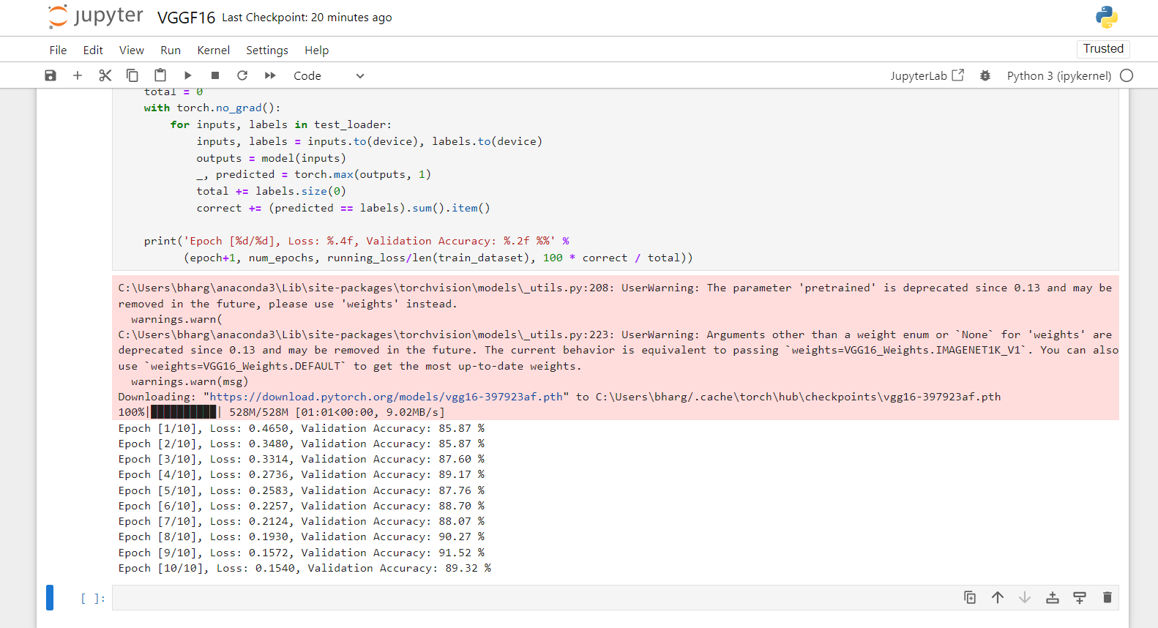
RESULTS :
VGG16 :
Average Accuracy : 88.415 %
Average Loss:
0.26186

Slide 25

CODE USED :

Slide 26


Slide 27
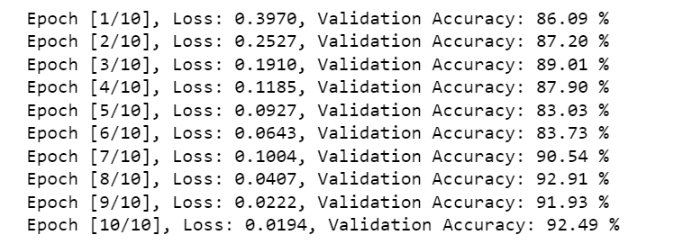
MobileNet :
Average Accuracy : 88.483 %
Average Loss:
0.12989

Slide 28

CODE USED :

Slide 29



Slide 30
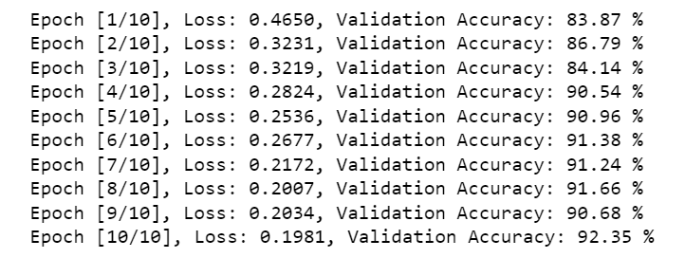
AlexNet :
Average Accuracy : 89.361 %
Average Loss:
0.2526

Slide 31

CODE USED :

Slide 32



Slide 33
Result Comparsion :
After comparing results of all the three models we can say that:
The accuracy of AlexNet model is the highest among the other models.

Slide 34
CONTRIBUTION:
The project: Identification Of Psychotic Disorder “SCHIZOPHRENIA” Using EEG Signals stand out due to its novel and unique features, setting it apart from existing solutions and making it a pioneering advancement in early detection :----
The first-time application of the STFT approach for detecting {s}-Group and {h}-Group represents a significant milestone in its utilization.
Analysis was conducted employing a deep learning model, emphasizing its effectiveness in detecting neurodegenerative diseases.
MobileNet emerged with the highest accuracy rate among the evaluated models, indicating its superiority in this regard.

Slide 35
REFERENCES :
https://www.mayoclinic.org/diseases-conditions/schizophrenia/symptoms-causes/syc-20354443
https://datasetsearch.research.google.com/search?src=0&query=eeg&docid=L2cvMTFybXhidDV3cQ%3D%3D
https://repod.icm.edu.pl/dataset.xhtml?persistentId=doi:10.18150/repod.0107441
https://www.nhs.uk/conditions/electroencephalogram/#:~:text=An%20electroencephalogram%20(EEG)%20is%20a,looked%20at%20by%20a%20doctor.
https://www.linkedin.com/pulse/vgg16-deep-learning-model-armando-aguilar-lopez-o5kic/
https://www.mygreatlearning.com/blog/alexnet-the-first-cnn-to-win-image-net/
https://www.geeksforgeeks.org/image-recognition-with-mobilenet/

